Slide 1
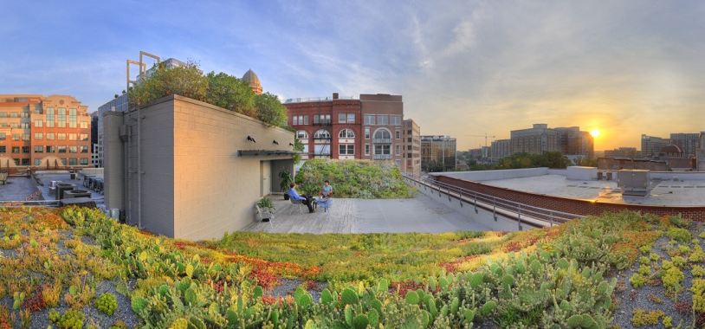

Slide 2
Presenter 1 Name
Title
Presenter 2 Name
Title

Slide 3
Agenda
About ASLA
What is Landscape Architecture?
Landscape Architecture and STEM
LA STEM Projects
LA Curriculum Comparison
STEM Designation
Discussion

Slide 4
American Society of Landscape Architects
MISSION
Landscape architects lead the planning, design, and stewardship of healthy, equitable, safe, and resilient environments. The Society’s mission is to advance landscape architecture through advocacy, communication, education, and fellowship.
VISION
Healthy, beautiful, and resilient places for all.
VALUES CULTURE
Excellence Collaborative
Integrity Inclusive
Diversity Member-Focused
Leadership Accountable
Stewardship Volunteer-Supported
Notes:
Read/summarize points from slide above.

Slide 5
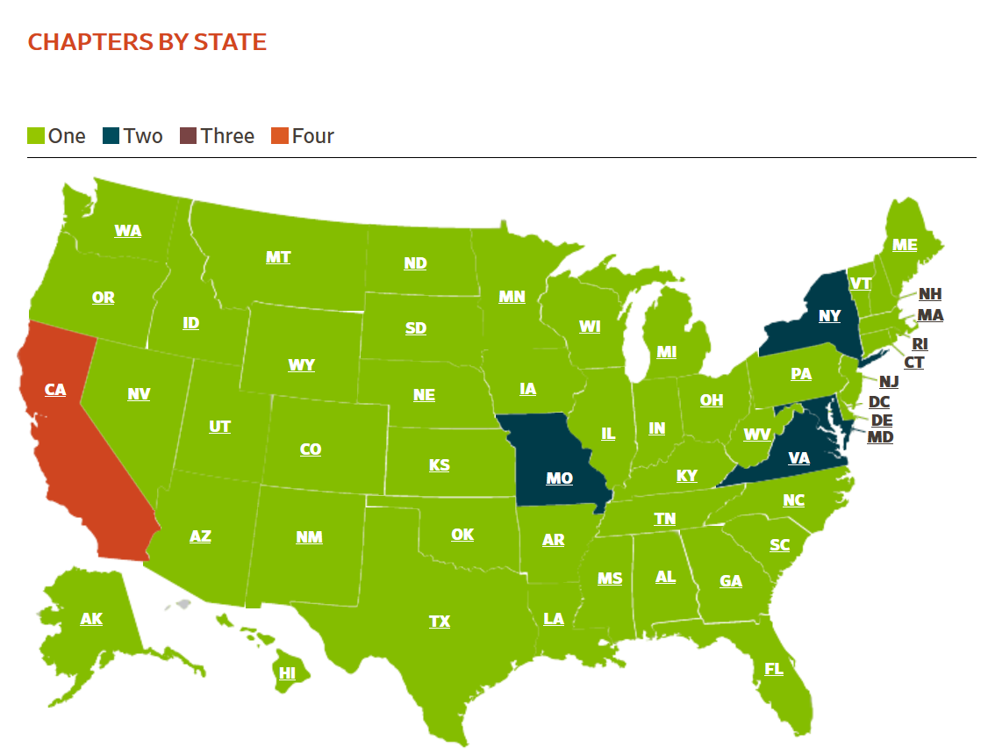
Notes:
Founded in 1899 as the national professional association for landscape architects, ASLA has more than 15,000 members and 49 chapters, representing all 50 states, U.S. territories, and 68 countries around the world.
Landscape architects are licensed in all 50 states and the District of Columbia.

Slide 6
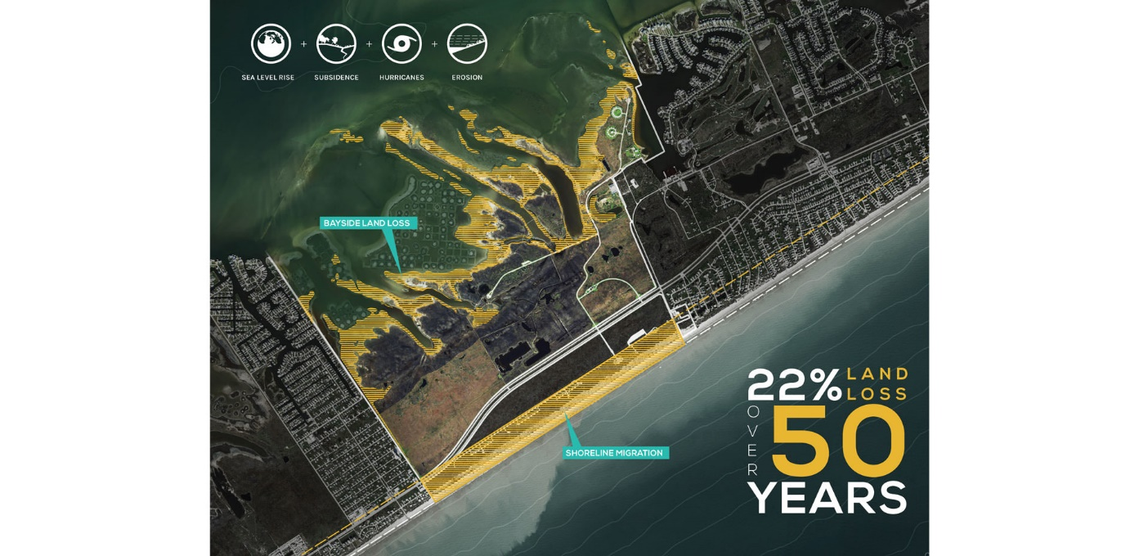
ASLA 2017 Professional Award of Excellence in Analysis and Planning. Storm + Sand + Sea + Strand: Barrier Island Resiliency Planning for Galveston Island State Park. Image by Studio Outside.
What is Landscape Architecture?
Notes:
Landscape architecture encompasses the analysis, planning, design, management, and stewardship of the natural and built environment.

Slide 7
Community Master Planning
Water & Stormwater
Commercial Development Projects
Transportation Design & Planning
Parks and Recreation
This is Landscape Architecture!
Notes:
In urban and rural communities alike, landscape architects are involved in the planning and design of community projects of many scales and scope.
From community master plans, multimodal transportation networks, transit-oriented development projects, outdoor park and recreation spaces, water and stormwater management projects, college campuses, public plazas and gathering spaces, and more.

Slide 8
Section 1: Project and Construction Management
Section 2: Inventory and Analysis
Section 3: Design
Section 4: Grading, Drainage, and Construction Documentation
Landscape Architect Registration Examination
(LARE)
Notes:
Landscape architecture starts with a rigorous STEM higher education, and culminates in a nationally administered four-part exam. The Landscape Architecture Registration Examination (LARE) tests a practitioner’s knowledge, skills, and abilities that directly relate to protecting public health, safety, and welfare, and one must pass all four sections of the exam in order to qualify to become licensed.
In order to become licensed, candidates must have a combination of education and experience, and pass the Landscape Architects Registration Exam (LARE).
The LARE tests a landscape architect’s knowledge, skills, and abilities that directly relate to protecting public health, safety, and welfare., and a candidate must pass all four sections of the test to qualify to become licensed.
The LARE exam is similar to other professionally licensed occupational exams, such as for architecture and engineering.

Slide 9
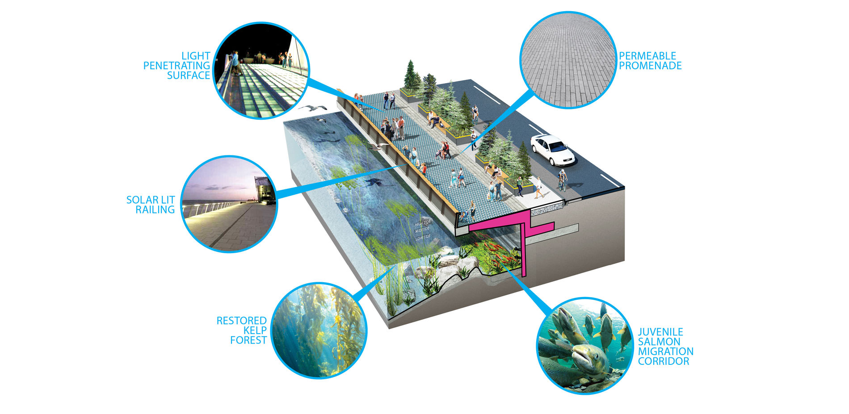
ASLA 2017 Professional Honor Award in General Design.
Central Seawall Project, James Corner Field Operations LLC.
Image by James Corner Field Operations LLC
Landscape Architecture and STEM
Notes:
Landscape architects, as stewards of the natural and built environments, routinely apply science, technology, engineering principles, and mathematics (STEM) in the planning and design of sites where millions of people live, work, and play.
Therefore, landscape architecture is inherently a STEM discipline.

Slide 10
ASLA 2016 ASLA Honor Award, Analysis & Planning. Baton Rouge Lakes
Baton Rouge, LA. Image by SWA Group in Association with CARBO Landscape Architecture
Landscape Architecture Professional Projects
and STEM Criteria
Notes:
Landscape architecture students must attend an accredited landscape architecture degree program, which is required to have the following curricular requirements that clearly fall into STEM:
plants and ecosystems, natural and cultural systems, including principles of sustainability;
design, planning and management at various scales and applications, including but not limited to pedestrian and vehicular circulation, grading, drainage, and stormwater management;
site design and implementation, including materials, methods, technologies, and application; construction documentation; computer applications and other advanced technology;
and quantitative research methods.
Next we’ll take a quick look at project examples that speak to each of the STEM categories of Science, Technology, Engineering, and Math.

Slide 11
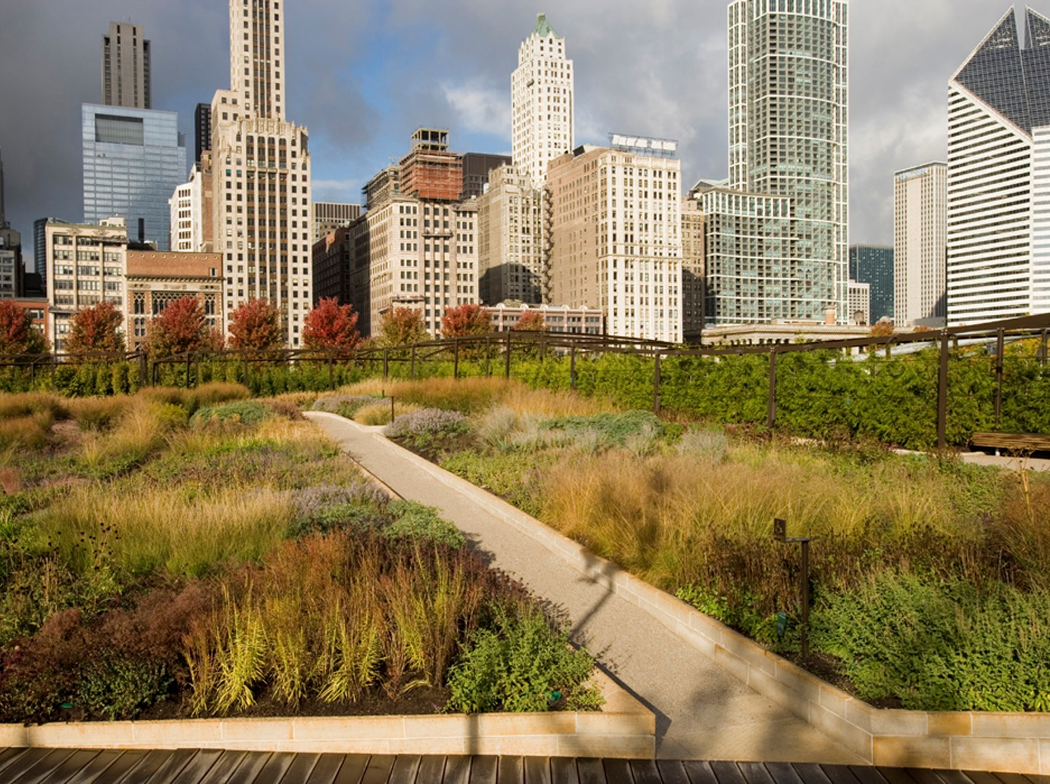
Millennium Park
Ecology
Environmental Sciences
Physical Sciences
Social and Cultural Sciences
ASLA 2008 Professional Award of Excellence. The Lurie Garden, Millennium Park,
Chicago, Illinois. Photo by Mark Tomaras.
Science
Notes:
Landscape architects use their knowledge of the physical sciences, environmental sciences, soil science, geology, botany, and horticulture, and their understanding of how these elements interact through ecology and natural systems, as a foundation for making decisions regarding land use.
In Millennium Park, Chicago, the intensive green roof provides 12.24 acres of permeable surface, making up almost half the park’s total surface area. Large areas of this permeable surface are planted zones, with 35,000 perennials, 5,800 woody plants, and 450 trees, 60% of which are native to the Midwestern U.S. These plantings have been designed as ecologically-sensitive and low-maintenance to increase biodiversity and lower costs. Within the park there are over 15 environmental education programs for both children and adults
(User can insert a local project that clearly illustrates the use of science in landscape architecture)

Slide 12
Shield Ranch
Computer Programming
and Planning
Geographic Information Systems (GIS)
LiDAR Technology
2D and 3D Design Software
Image courtesy of Lurie Garden
ASLA 2018 ASLA Professional Honor Award, Analysis and Planning. From Pixels to Stewardship: Advancing Conservation Through Digital Innovation. Travis County, TX. Image by Andropogan Associates, Ltd.
Technology
Notes:
Landscape architects use cutting edge technology to determine best planning and design practices for specialized land uses. From Geographic Information Systems (GIS), to LiDAR, and 2D and 3D Design software, and others, landscape architects are using these technologies to improve the efficiency and functionality of spaces.
With Shield Ranch in Texas, landscape architects used mapping in GIS to characterize typologies of water movement to identify hydro-geologically-sensitive landscapes. These maps depict anticipated floodplains, steep slopes, risers, boundaries between geologic formations, and soils at risk for erosion. GIS has also been integrated with smartphone technology to develop a collective knowledge of scientist’s findings, site analysis field research and family history towards the development of a comprehensive assessment of the Ranch‘s future integrity.
LiDAR technology was also used to receive high-resolution point-cloud data to model topography and vegetation, constructing a model to analyze water movement in complex geologies, the diverse landscapes, ecological communities, viewsheds, and soundscapes.
(User can insert a local project that clearly illustrates the use of technology in landscape architecture)

Slide 13
Seattle Waterfront
Structure and Capacity
Materials and Joints
Codes and Regulations
Construction Documents
and Specifications
ASLA 2017 Professional Honor Award in General Design. Central Seawall Project, James Corner Field Operations LLC. | Courtesy of James Corner Field Operations LLC
Engineering
Notes:
Landscape architects create solutions using physical sciences and engineering principles for many outdoor problems, including the manipulation of landforms through grading, drainage-system design, stormwater management, erosion control, and retaining walls.
Landscape architects employ engineering principles, an understanding of structures, materials and construction processes, and federal, state, and local codes and standards to insure that our communities are designed to protect the health, safety, and welfare of all users.
For example, the Seattle Waterfront redevelopment project, led by a landscape architecture firm used a boring machine to dig the tunnel under the City of Seattle to re-route the Alaskan Way Viaduct below the city, which necessitated the revised ground level street connections that incorporate bike and pedestrian traffic.
The weakening seawall was replaced to protect the coastal city from impending damage and stormwater events.
(User can insert a local project that clearly illustrates the use of Engineering in landscape architecture)

Slide 14
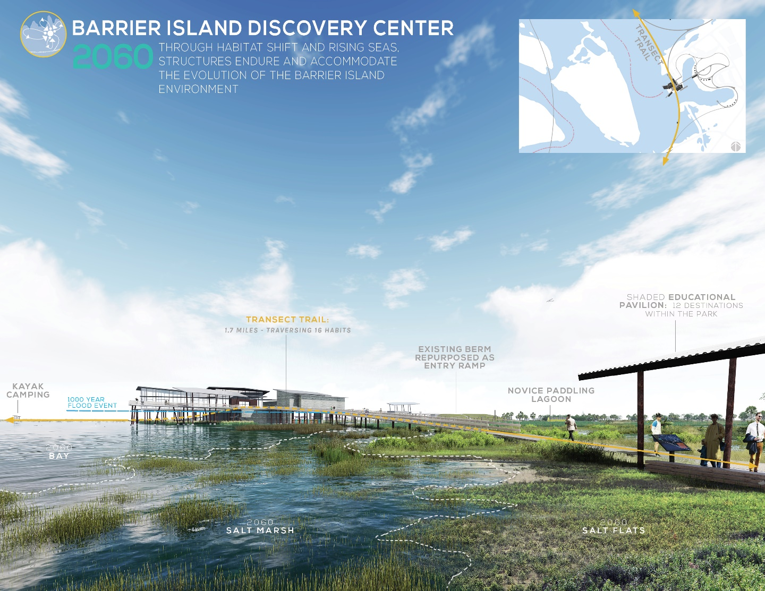
Galveston Island State Park
Grading and Earthworks
Project Cost Estimates
Architectural drafting
Structural Loads
Pre- and Post-Occupancy Evaluations
ASLA 2017 Professional Award of Excellence. Barrier Island Resiliency Planning for Galveston Island State Park. Galveston, TX. Studio Outside.
Mathematics
Notes:
Landscape architects study patterns and relationships in nature and execute a variety of calculations both for creating solutions and as inspiration for design solutions.
Landscape architects utilize higher level mathematical computations to ensure the viability, structural soundness, resiliency, and performance of projects.
Research methods, including quantitative analysis and performance matrices, are employed for pre- and post-construction assessment studies.
At Galveston Island State Park, landscape architects used percentage calculations to reveal the damage of predictive sea level rise in order to create the master plan site strategy. Site-specific results disclose a prediction of high, medium and low calculations of land loss. Based on the results, the master plan strategizes around the mid-range scenario of a 22% land loss for 2060, turning much of the land into open water or marsh.
(User can insert a local project that clearly illustrates the use of Mathematics in landscape architecture)

Slide 15
Environmental studies
Environmental science
Sustainability studies
Plant science
Urban forestry
Natural resources conservation
Landscape Architecture Curriculum Comparison
Notes:
Landscape architecture is not currently approved as a STEM Designated Degree Program by the Department of Homeland Security ( DHS). However, numerous allied disciplines are found on the DHS-approved list, including …
Environmental studies
Environmental science
Sustainability studies
Plant science
Urban forestry
Natural resources conservation

Slide 16
STEM Comparison | Required STEM-focused courses | Required courses with some STEM content | Optional courses that may include STEM content | Required or optional courses with little or no STEM content
Master of Landscape Architecture Harvard University | 13% | 47% | 33% | 7%
Master of Environmental Studies University of Pennsylvania | 8% | 17% | 75% | -
Master of Sustainability Arizona State University | - | 16% | 49% | 35%
Landscape Architecture Curriculum Comparison
Notes:
As we look into this further we find that Environmental studies (CIP code 3.0103) and sustainability studies (CIP code 30.3301) have considerable overlap with landscape architecture (CIP code 04.0601).
Internal research comparing the Master of Landscape Architecture program at Harvard with the renowned Environmental Studies Program at the University of Pennsylvania and the Master of Sustainability Program at Arizona State University, both of which are the premiere programs in their respective disciplines, one finds higher overall STEM content in the required course material of the landscape architecture program. (REFERENCE CHART AND COMPARE LA TO OTHER PROGRAMS, POINTING OUT %)
This analysis clearly demonstrates the breadth of STEM content for the landscape architecture program in comparison to other STEM-designated programs.
ASLA’s Education Department is crafting a STEM White Paper that provides a “deeper dive” into comparing current STEM programs and curriculums to landscape architecture programs to make the case for the profession’s DHS STEM designation.

Slide 17
FEDERAL
Bureau of Labor Statistics
Office of Management and Budget
Government Accountability Office
Census Bureau
Congressional Research Service
STATE
Connecticut
Florida
New York
Current LA STEM Designations
Notes:
The evidence is clear - Landscape Architecture is a STEM discipline.
The scope and breadth of the profession, the types of landscape architecture STEM projects, the curriculum comparison with allied professions clearly demonstrates that landscape architecture is a STEM discipline.
Further, many federal agencies and states recognize landscape architecture as STEM.
The Bureau of Labor Statistics Standard Occupational Classification (SOC) System recognizes landscape architecture as a science and engineering related domain.
Under this system, landscape architecture is grouped with civil engineers, architectural and civil drafters, environmental engineers, and surveyors, all of which are included on the DHS STEM Designated Degree Program List.
Additionally, the Office of Management and Budget (OMB) updated its STEM recommendations in June 2019 and Landscape Architecture retained its recommended STEM status.
Further, several states formally define landscape architecture as a STEM discipline. For example, the Departments of Labor in both New York and Connecticut recognize landscape architecture as a STEM profession.
The state of Florida also recognizes landscape architecture as a STEM degree program through the Board of Governors’ State University System’s list of “Programs of Strategic Emphasis.”
However DHS does not recognize landscape architecture as a stem discipline on their Designated Degree Program List.
Having DHS recognize la as STEM will open opportunities for students globally to study in our world class institutions across the U.S.

Slide 18
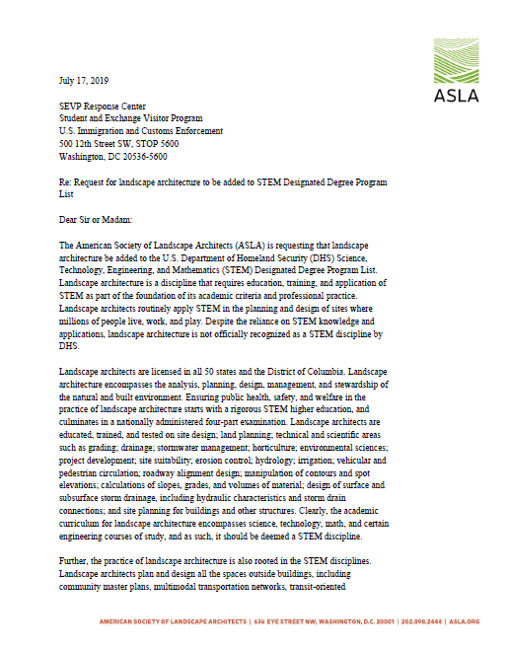
ASLA Letter to the Department of Homeland Security
Notes:
On July 17, 2019, ASLA delivered a comprehensive letter to the U.S. Immigration and Customs Enforcement (ICE) requesting that landscape architecture be added to the U.S. Department of Homeland Security (DHS) Science, Technology, Engineering, and Mathematics (STEM) Designated Degree Program List.
The letter highlighted key reasons for designating landscape architecture as a STEM discipline.
Since then, ASLA received a response from the Student and Exchange Visitor Program (SEVP) Response Center within ICE stating “SEVP has added your recommendation to the list maintained for the U.S. Department of Homeland Security (DHS) per the requirements of the STEM OPT Final Rule.”
It goes on to state, “if the code in question is officially added to the list of approved codes in the future, the new addition will be announced via a Broadcast Message and posted to the SEVP website.”
It is unclear when DHS will update the list, however, the last update to the approved list was posted May 10, 2016.
ASLA’s Government Affairs and Education departments will continue to work on follow up actions with DHS to further convince the Department that landscape architecture merits STEM designation and recognition.

Slide 19
STEM Education Coalition
Notes:
Recently, ASLA joined the STEM Education Coalition to help further ASLA’s goal of achieving STEM designation and recognition.
The STEM Education Coalition’s mission is to raise awareness amongst policymakers at every level about the critical role that STEM education plays in enabling the U.S. to remain the economic and technological leader of the global marketplace of the 21st century. The Coalition believes that our nation must improve the way our students learn STEM and that the business, education, and STEM communities must work together to achieve this goal.

Slide 20
University of Pennsylvania Landscape
Architecture Department
Professor Richard Weller
Mapping the Crisis
Landscape Architecture and STEM
Notes:
There are 96 accredited landscape architecture programs within 70 institutions across the country; however, the professional demand is far outpacing the supply of students.
According to the Bureau of Labor Statistics, the need for planning and developing new and existing sites for commercial, industrial, and residential construction projects is expected to drive employment growth. Additionally, environmental concerns and increased demand for sustainably designed buildings and open spaces should spur demand for the services of landscape architects.
Furthermore, efforts to conserve water, prevent waterway pollution, mitigate flooding, and control wildfires are expected to persist.
Landscape architects will be needed to design plans for managing these efforts. To address the need for more landscape architects, the DHS STEM designation will allow universities to recruit landscape architecture students from a global pool of willing and qualified candidates.
Receiving DHS’s STEM Designated Degree Program recognition will allow these students to remain in our country and work to help address our nation’s growing needs and concerns by putting into practice the knowledge that they have gained.

Slide 21
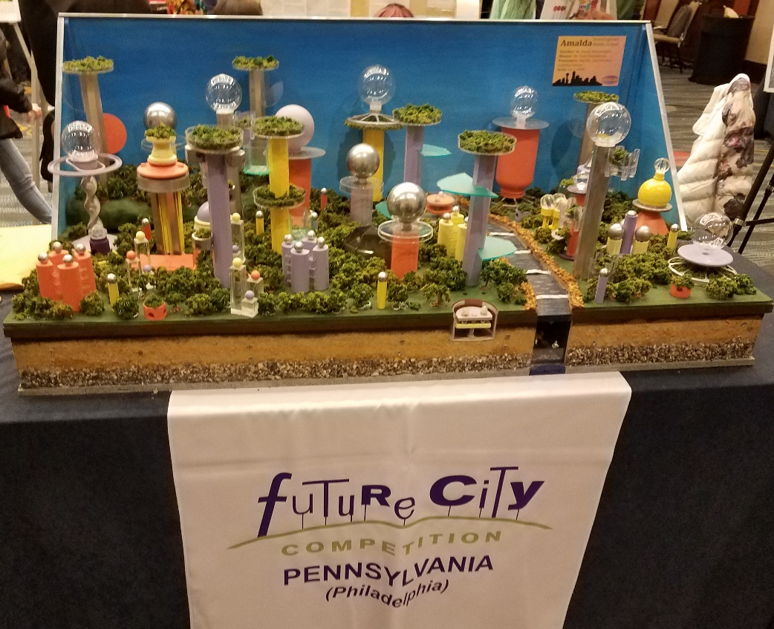
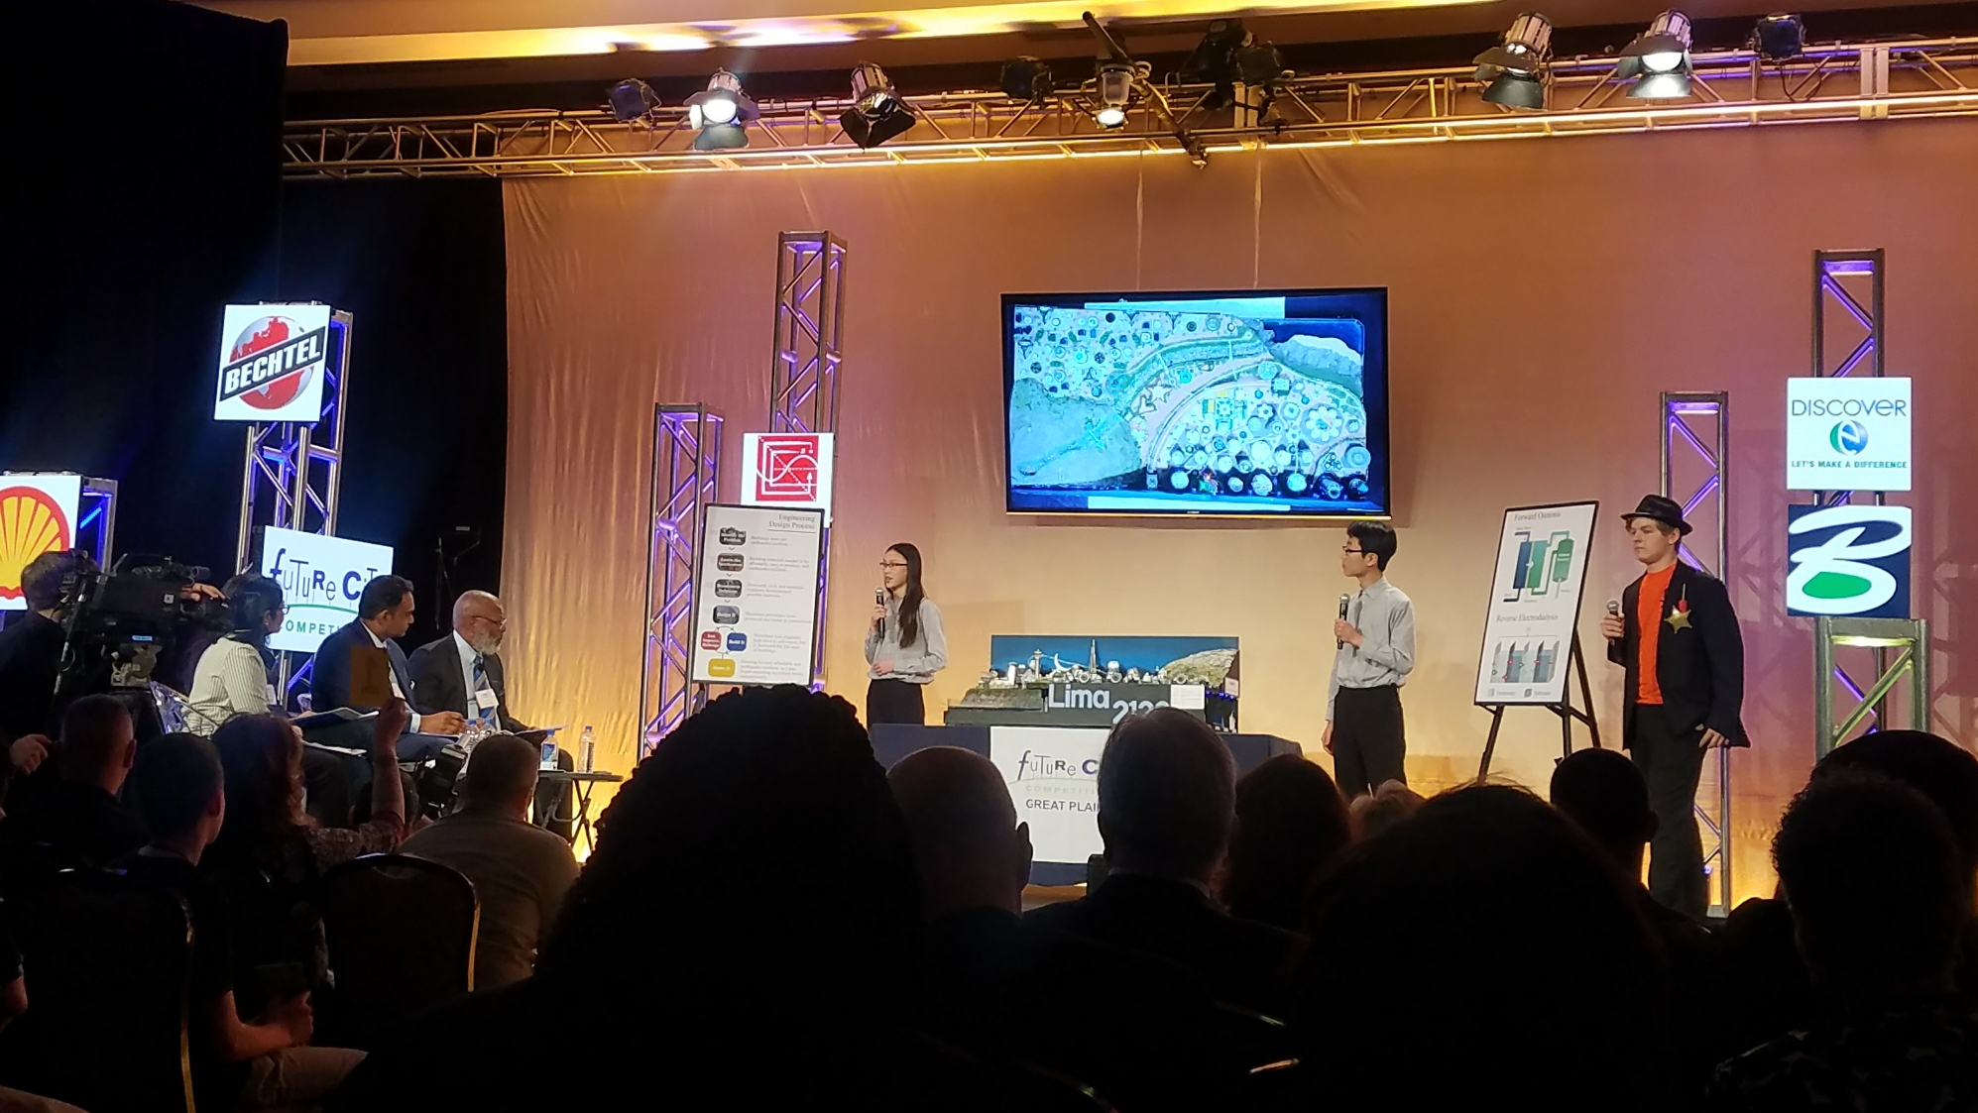
Notes:
ASLA national and members across the country are leading a variety of local STEM-centered activities and initiatives with schools, firms, built environment museums and more. In addition to our partnership with the STEM Ed Coalition, ASLA is also an ongoing sponsor of Future City, one of the nation’s leading engineering education programs for middle school students. ASLA’s participation in the annual Competition introduced more than 45,000 middle school students to the landscape architecture profession through ASLA’s special award for Best Integration of Equity in Designing the Built Environment using Nature-Powered Solutions.

Slide 22
Thank you!
Presenter 1 Name
Email address
Presenter 2 Name
Email address

